Slide 1
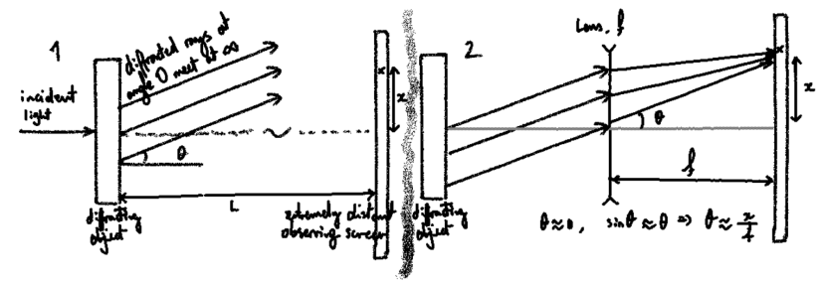
Lens, f
diffracted rays at angle 0 meet at ∞
incident light
x
x
f
diffracting object
L
extremely distant observing screen
diffracting object
When θ ≈ 0, sinθ ≈ θ ⇒ θ ≈ x/f

Slide 2
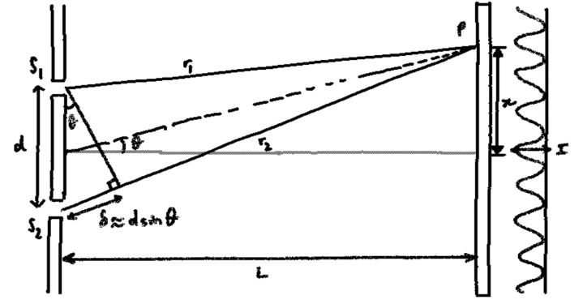
P
S₁
r₁
x
d
r₂
I
δ ≈ d sinθ
S₂
L

